Slide 1
The Dynamics of Shame

Slide 2
A definition
Shame is an intensely painful feeling or experience of believing we are flawed and therefore unworthy of acceptance or belonging.
Shame is about the self while guilt is about a thing done or undone.
Often because of the pain they feel people do not consciously recognise that they are feeling shame.
Expressing shame is the start to it being diminished.

Slide 3
Shame can be experienced by
* the person causing the harm
* the person harmed
* the support people
* the faciltators

Slide 4
Shame is frequently overlooked because it has many hiding places.
Many of the symptoms of shame can can be indicative of other dynamics.
Shame often develops early in a persons life and they are unaware of its effects on their behaviour.

Slide 5
Ongoing blaming and shaming creates toxic shame. This can become a prison. It cuts people off from their feelings and restricts their ability to change.
This is in contrast to healthy shame which gives us permission to be human and make mistakes.
It is important not to challenge peoples awareness to directly if they are locked in toxic shame.

Slide 6
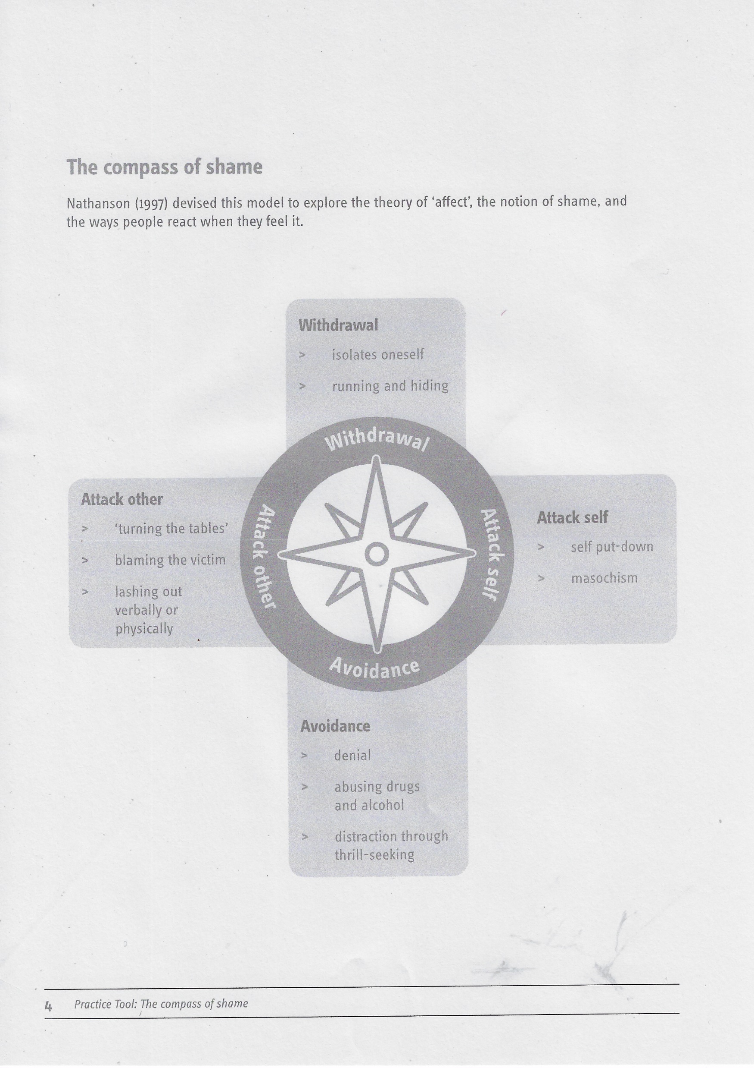
Common responses to toxic Change

Slide 7
Other Responses to shame
Move towards self
Move towards others

